Slide 1

Machine Learning
Artificial Intelligence
School of Computing
Universiti Teknologi Malaysia

Slide 2
Machine Learning
How do we teach a machine to learn?

Slide 3
Content
Machine learning process
From data to features
Learning types
Supervised learning
Unsupervised learning
Reinforcement learning
Machine learning techniques
Clustering, classification, regression
Evaluation metrics
Computational intelligence

Slide 4
Machine Learning
Learning Process

Slide 5
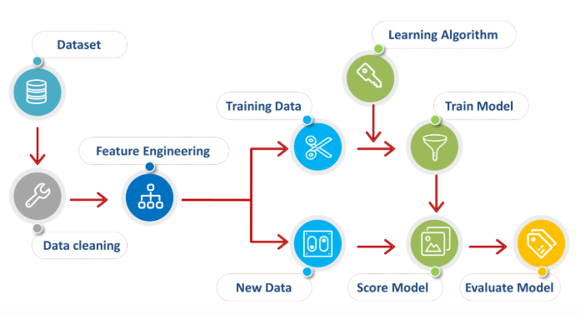
Machine Learning Process
What is Machine Learning?
Computational learning using algorithms to learn from and make predictions on data.
Predict a value

Slide 6
How machine learns?
Machine learning utilizes techniques of understanding patterns from input data
Data is used for training by learning algorithm to learn and develop a specific computational model
Pre-processing involves extracting important features of data
Model refers to predefined prototype problem solver, produced based on patterns of input data

Slide 7
Machine Learning
From Data to Features

Slide 8
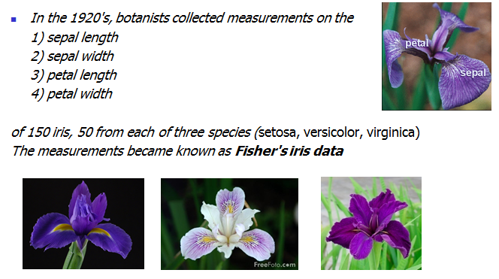
Some real data

Slide 9
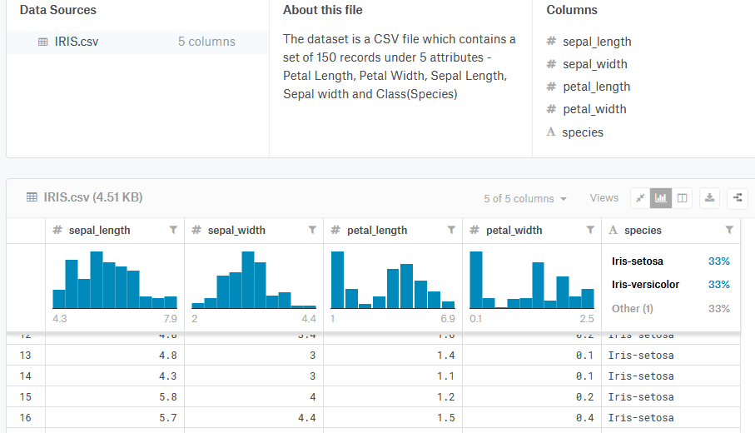
Iris data
https://www.kaggle.com/arshid/iris-flower-dataset

Slide 10
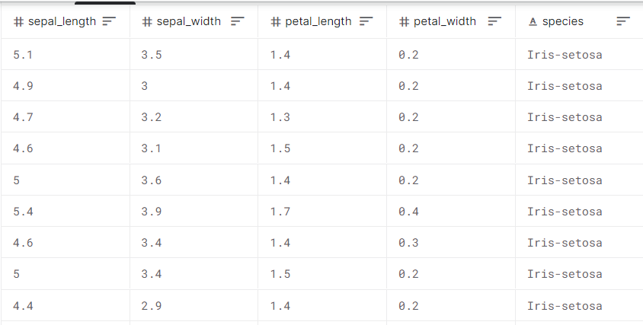
Data to Features
Collection of data observations and their attributes/features
Attribute is the properties or characteristics of the data object
Attribute is aka feature / field / characteristic / variable
Observation/instances/examples/samples/objects/records
Class

Slide 11
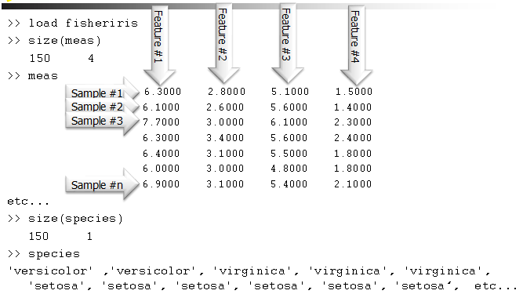
Iris data

Slide 12
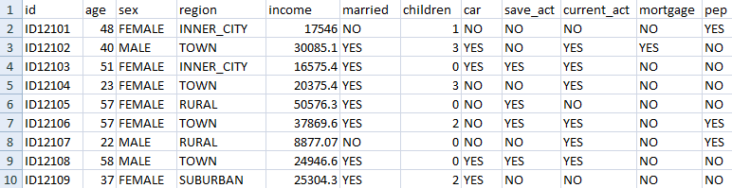
Data to Features
Collection of data observations and their attributes/features
Attribute is the properties or characteristics of the data object
Attribute is aka feature / field / characteristic / variable
Observation/instances/examples/samples/objects/records
Class

Slide 13
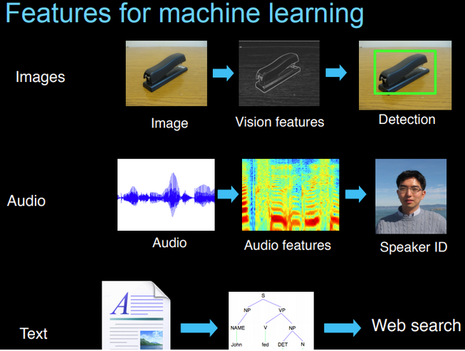
Features can be from many forms of data; images, audio or text

Slide 14
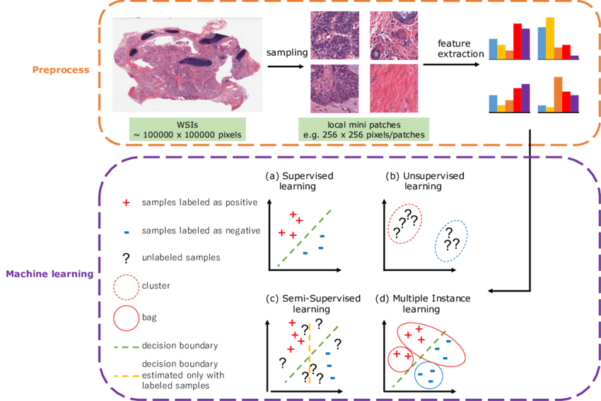
Real world example: Steps of ML in digital pathological image analysis

Slide 15
Machine Learning
Learning Types

Slide 16
Learning types
Supervised learning
The correct classes of the training data are known
Unsupervised learning
The correct classes of the training data are NOT known
Reinforcement learning
Machine learn its behavior based on feedback from environment

Slide 17
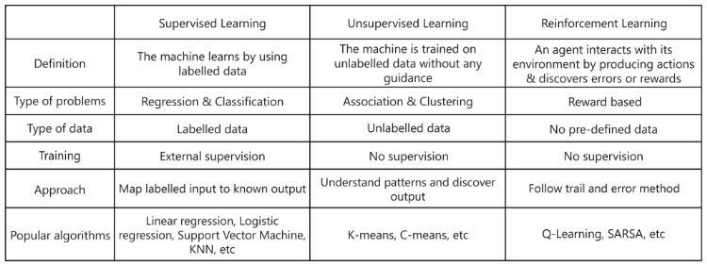
Learning types
Notes:
K-means algorithm is an example of machine that is trained on _________________ without any guidance.
Unlabelled data
Labelled data
Reward data
Environment data

Slide 18
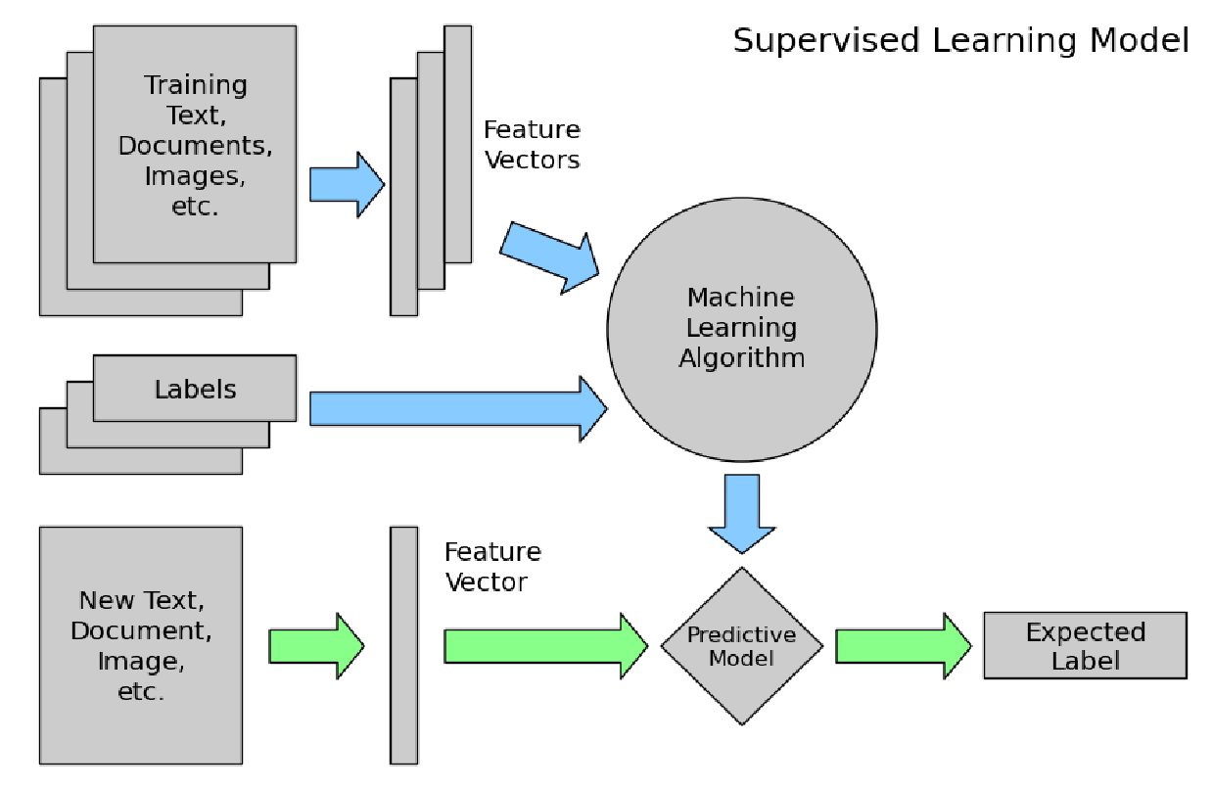
1. Supervised Learning

Slide 19
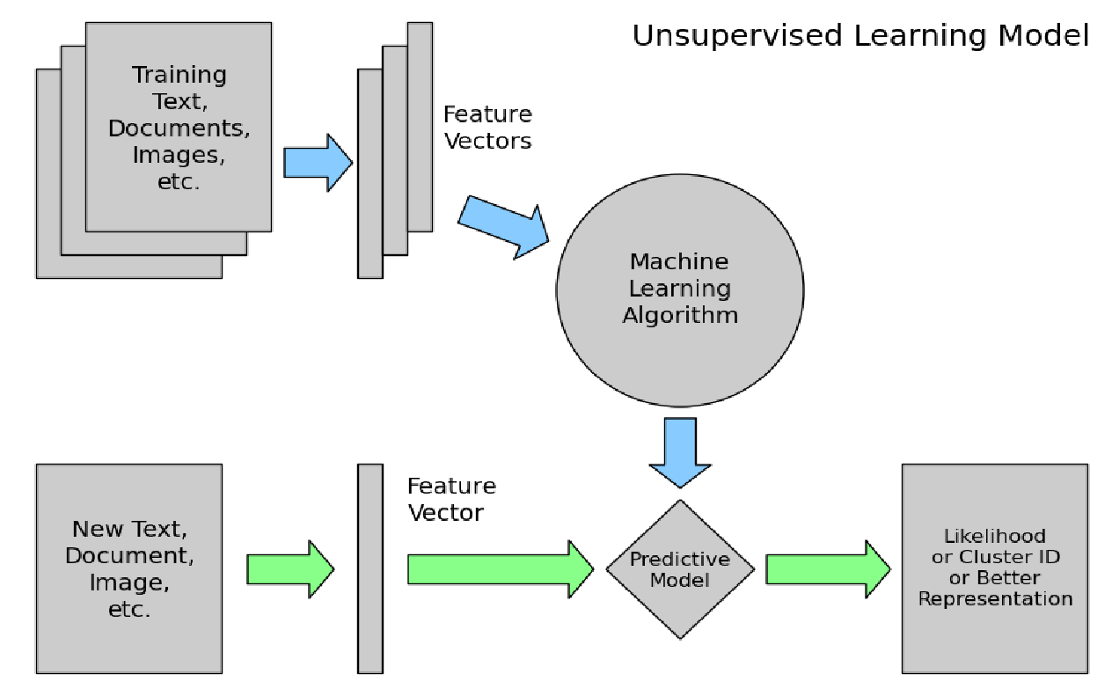
2. Unsupervised Learning

Slide 20
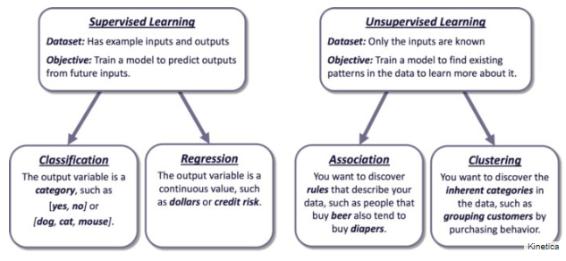
Supervised vs unsupervised

Slide 21
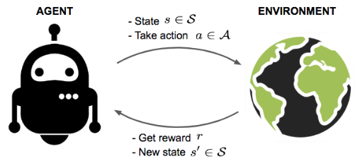
3. Reinforcement learning
An agent interacts with the environment trying to take smart actions to maximize cumulative rewards
The environment is formulated using Markov decision process to search for solutions
Notes:
In ___________________, an agent interacts with the environment trying to take smart actions to maximize cumulative rewards
Supervised
Unsupervised
Reinforcement
Regression
A cluster refers to a collection of data points aggregated together because of certain _______________________________
Similarities
Differences
Uniqueness
Distances
K-means algorithm is an example of machine that is trained on _________________ without any guidance.
Unlabelled data
Labelled data
Reward data
Environment data

Slide 22
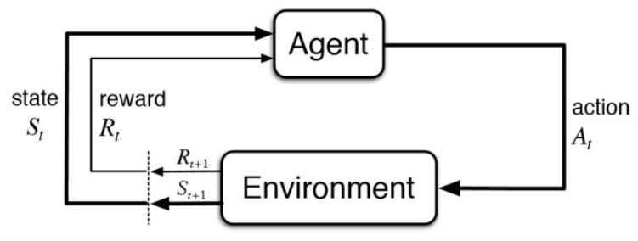
Markov Decision Process (MDP)
Feedback from the environment
Action that agent performs in environment
Current situation of the agent
Physical world in which the agent operates
Notes:
The agent is acting in an environment
How the environment reacts to certain actions is defined by a model which we may or may not know
The agent can stay in one of the many states S of the environment and choose to take one of the many actions A so that it can switch from one state to another
Which state the agent will arrive is determined by transition probabilities P between states
Once an action is taken, a reward R is delivered by the environment as feedback

Slide 23
Markov Decision Process (MDP)
The agent is acting in an environment
How the environment reacts to certain actions is defined by a model which we may or may not know
The agent can stay in one of the many states S of the environment and choose to take one of the many actions A so that it can switch from one state to another
Which state the agent will arrive is determined by transition probabilities P between states
Once an action is taken, a reward R is delivered by the environment as feedback

Slide 24
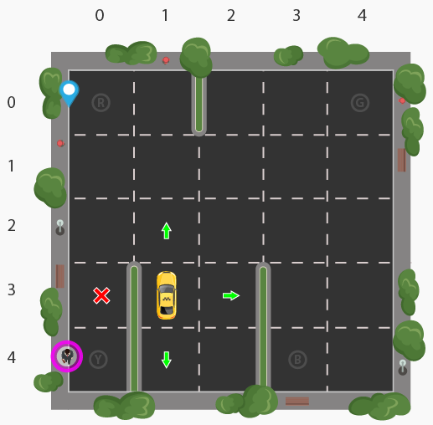
Example of RL for self-driving cab
Self-driving cab (agent) must drop off passenger at the right location (R,G,B,Y)
Passenger is at Y and wants to go to R
Rewards; successful dropoff by agent will get +reward, otherwise agent will be penalized/-reward
State space; all possible situations the cab can be in
5 x 5 x 5 x 4 = 500 possible states
5x5 (grid), 5 passengers location (4 in the cab, 1 waiting), 4 locations (R,G,B,Y)
Action space; six possible actions to be south, north, east, west, pickup and dropoff
Notes:
Taken from https://www.learndatasci.com/tutorials/reinforcement-q-learning-scratch-python-openai-gym/

Slide 25
RL in real world
Games
AlphaGo, AlphaGo Zero etc
Robotic
(remember Spot from BostonDynamics?)
Traffic light control
Web system configuration
And many more

Slide 26
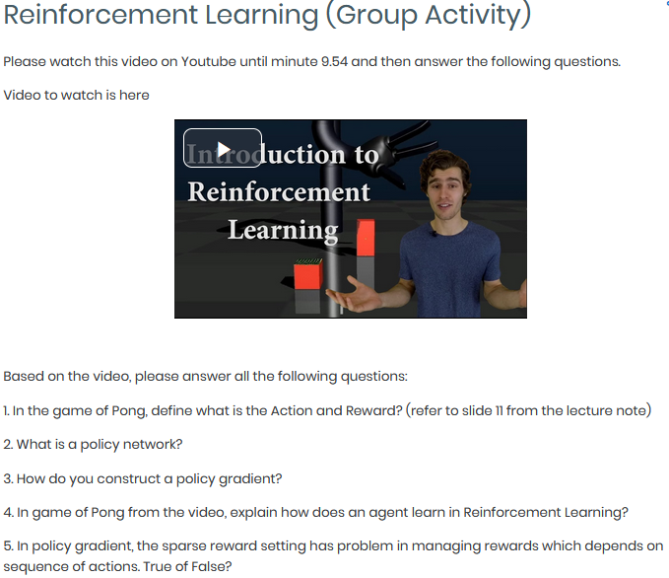
Activity 1.0: Forum on RL https://www.youtube.com/watch?v=JgvyzIkgxF0
Notes:
Discussion and example on RL - https://www.youtube.com/watch?v=JgvyzIkgxF0
A good explanation of RL in game of Pong - http://karpathy.github.io/2016/05/31/rl/
Playing Pong with RL - https://towardsdatascience.com/intro-to-reinforcement-learning-pong-92a94aa0f84d

Slide 27
Machine Learning
Learning Techniques

Slide 28
Machine learning techniques
Classification
Predict class from observation
Clustering
Group observations into ‘’meaningful” groups
Regression
Predict value from observations

Slide 29
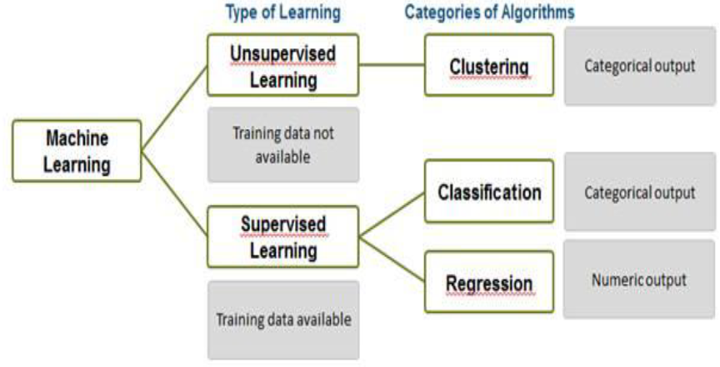
Classification and clustering

Slide 30
Clustering
Clustering is identifying similar groups of data in a dataset
We assume that observations in each group are comparatively more similar to observations of that group compared to those of the other groups
A cluster refers to a collection of data points aggregated together because of certain similarities
E.g. try to understand customers better so that we can market our products to them better. How do we start?
E.g. try to find your close-knit groups of friends on Facebook? How will you identify them?
Notes:
A cluster refers to a collection of data points aggregated together because of certain similarities
Similarities
Differences
Uniqueness
Distances

Slide 31
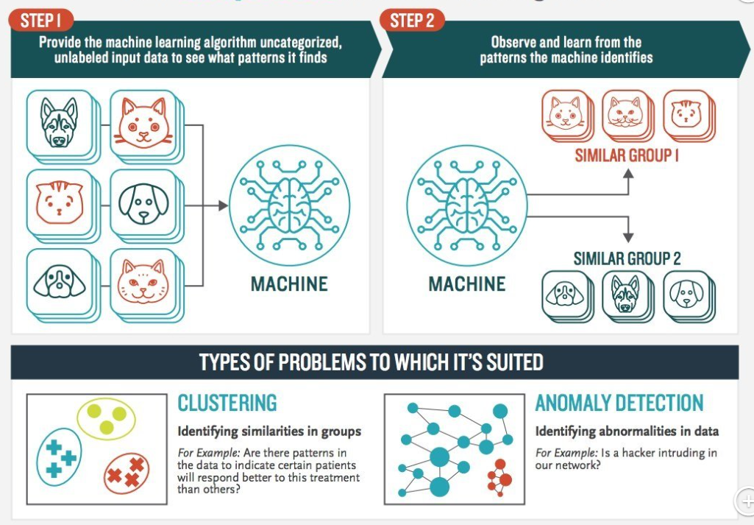
How clustering works

Slide 32
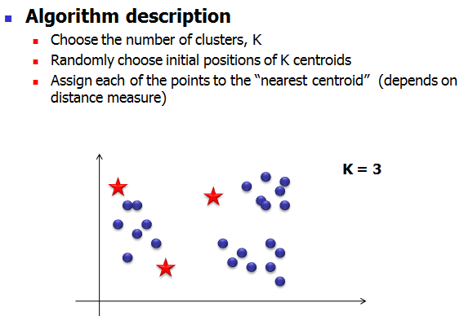
Clustering (k-mean algorithm)

Slide 33
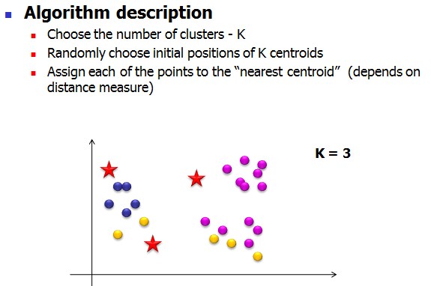
Clustering (k-mean algorithm)

Slide 34
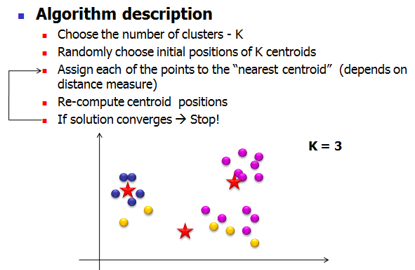
Clustering (k-mean algorithm)
Until no data be choose

Slide 35
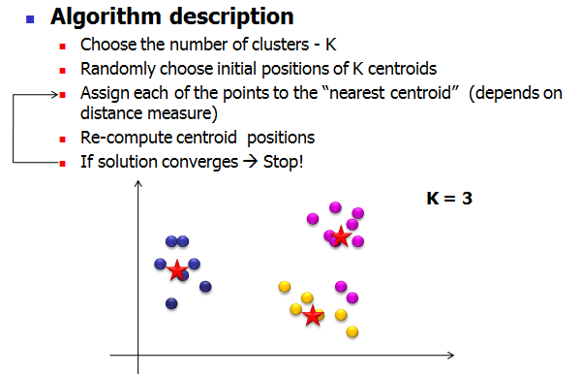
Clustering (k-mean algorithm)

Slide 36
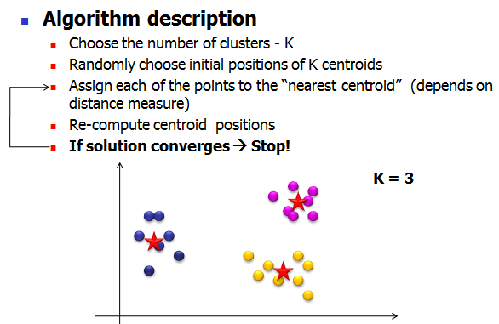
Clustering (k-mean algorithm)
Group together by cluster
Aggregated group

Slide 37
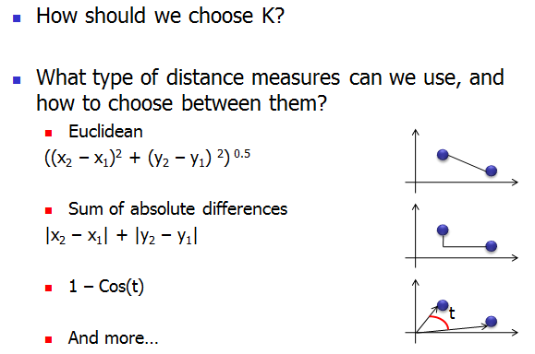
Distance measure for k-mean

Slide 38
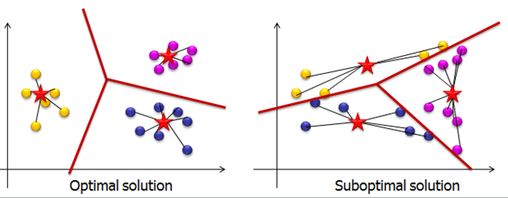
Clustering (k-mean algorithm)
Find similarities among all observations such that similar observations can be put in clusters
Computing distance from each observation/data point to centroids to obtain well-represented clusters.
Why are they optimal and suboptimal solution? Can you guess?

Slide 39
Clustering (k-mean algorithm)
Centroid == mean i.e. averaging the data
Data points are allocated to the nearest centroid/cluster as to keep the centroids as small as possible
Optimal solution means it is easier to distinguish between each cluster i.e. better boundary separation
Find similarities among all observations such that similar observations can be put in clusters
Computing distance from each observation/data point to the centroids to obtain well-represented clusters.
Why are they optimal and suboptimal solution? Can you guess?

Slide 40
Classification
Classification refers to predicting the class of given observations/data points
Class means targets/labels or sometimes categories
In classification, we are mapping the input data to specific type of class/category

Slide 41
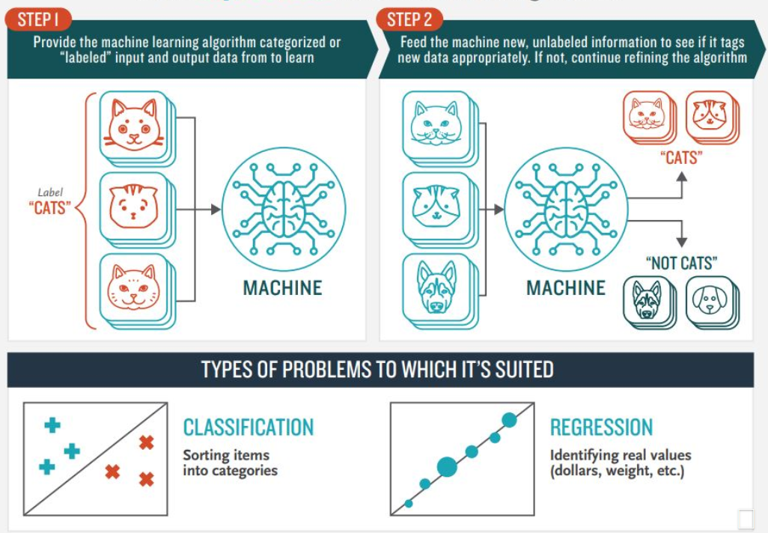
How classification works
Notes:
Data set = features and class label
Data separated into training data and testing data
ML algorithm predicts the class label of the testing data

Slide 42
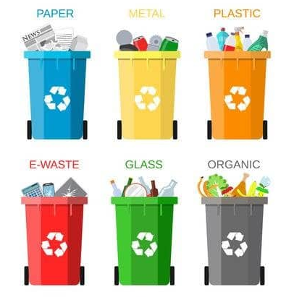
Classification
Classification of waste
You know beforehand each bin category/class of the waste
How do you decide which waste goes to which bin?
We learn from the waste i.e. from the data points, then we can decide to which class it belongs to

Slide 43
Classification
The data that gets input to the classifier may contains four measurements for waste e.g. 1)what material it is made from, 2)size, 3)weight and its 4)biodegradable level
The job of the classifier then is to output the correct waste type for every input

Slide 44
Classification algorithms
Decision tree
Naïve Bayes
ANN, now evolving into Deep Learning
Random Forest
K-Nearest Neighbour
Support Vector Machine (SVM)
And many more!

Slide 45
Machine Learning
Performance Evaluation

Slide 46
How good is the learning model?
The aim of a model is to be able to produce good results
Employ another set of data called testing data to evaluate the learning model
Can be completely new
Blinded dataset from the same resource
Smaller part of training data previously separated
Rule of thumb for train-test split (holdout method); 70%:30, 80%:20%, 90%:10%

Slide 47
Performance measures / Evaluation metrics
Confusion matrix to evaluate the performance of ML methods (higher % better performance)
E.g. of performance measures
% game won
% correctly classified images
% correctly identified text
 |  | Predicted Class
 |  | Yes | No
Actual Class | Yes | True Positive (TP) | False Negative (FN)
 | No | False Positive (FP) | True Negative (TN)

Slide 48
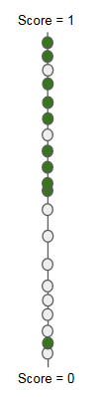
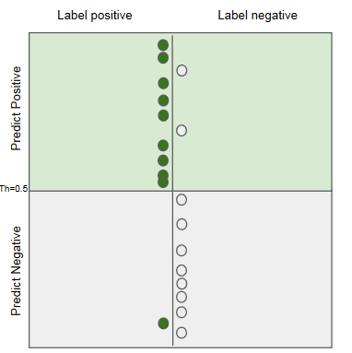
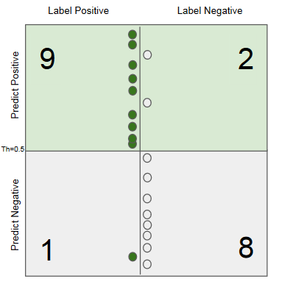
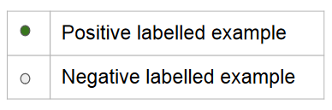
Confusion matrix
Construct

Slide 49
 |  | Predicted Class
 |  | Yes | No
Actual Class | Yes | True Positive (TP) | False Negative (FN)
 | No | False Positive (FP) | True Negative (TN)
TP = 9 (positive observation correctly identified as positive)
TN = 8 (negative observation correctly identified as negative)
FP = 2 (positive that is false i.e. negative observation incorrectly identified as positive)
FN = 1 (negative that is false i.e. positive observation incorrectly identified as negative)
Differenetsiate +ve -Ve

Slide 50
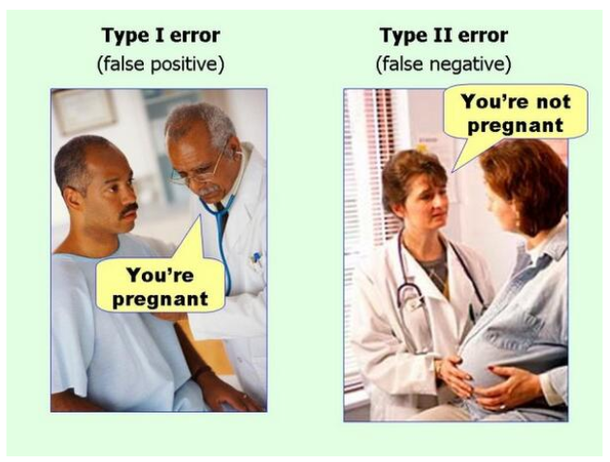
Type I error = FP and Type II error = FN
Lets say positive test result means ‘is pregnant’

Slide 51
Performance measures from confusion matrix
 |  | Predicted Class
 |  | Yes | No
Actual Class | Yes | True Positive (TP) | False Negative (FN)
 | No | False Positive (FP) | True Negative (TN)
Accuracy = TP+TN / (TP+TN+FP+FN) i.e. 1 – error
Precision = TP/(TP+FP)
Recall = TP/(TP+FN)
The closer the score to 1, the better the classifier model
High recall, low precision: This means that most of the positive examples are correctly recognized (low FN) but there are a lot of false positives.
Low recall, high precision: This shows that we miss a lot of positive examples (high FN) but those we predict as positive are indeed positive (low FP)

Slide 52
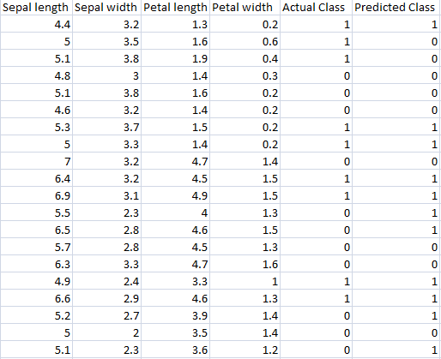
Activity 2.0: Confusion matrix
Let positive be 1, and negative is 0;
Given the Iris dataset as in the table, quantify TP, TN, FP and FN
Determine the accuracy, precision and recall

Slide 53
Activity 2.0 Answer: Confusion matrix
 | Predicted: 0 | Predicted: 1
Actual: 0 | 7 | 2
Actual: 1 | 4 | 7
TP=7, TN=7, FN=2, FP=4
Accuracy = TP+TN / (TP+TN+FP+FN)
=7+7/ (7+7+2+4) = 0.7
Recall = TP/(TP+FN) = 7/(7+2)=0.78
Precision = TP/(TP+FP)= 7/(7+4) = 0.64

Slide 54
How real world use ML?
https://towardsdatascience.com/real-world-examples-of-applied-machine-learning-from-ai-conference-4d4678700c6
Real world examples
Uber COTA (Customer Obsession Ticket Assistant)
http://w4nderlu.st/assets/javascript/ViewerJS/#http://w4nderlu.st/content/3-publications/cota-improving-the-speed-and-accuracy-of-customer-support-through-ranking-and-deep-networks/cota-o-reilly-ai-conference-2018.pdf
AirBNB ; categorizing listing photos
https://medium.com/airbnb-engineering/categorizing-listing-photos-at-airbnb-f9483f3ab7e3
ZocDoc ; finding in network physicians from insurance cards
https://www.zocdoc.com/about/blog/tech/making-sense-of-insurance-cards-using-deep-learning/
Spotify ; How does it know your kind of music?
https://medium.com/s/story/spotifys-discover-weekly-how-machine-learning-finds-your-new-music-19a41ab76efe

Slide 55
Computational Intelligence
What methods machines use to learn?

Slide 56
Outline
What is AI?
Now, come Computational Intelligence (CI)
Scope of CI
Importance of CI
CI Techniques
Artificial Neural Network
Genetic Algorithm
Fuzzy Logic

Slide 57
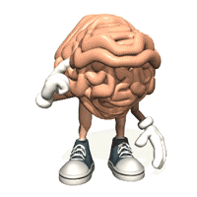
What is AI?
Ability to interact with the real world
Reasoning and Planning
Learning and Adaptation

Slide 58
Now, come Computational Intelligence (CI)
A methodology involving computing that exhibits an ability to learn and/or to deal with new situations, such that the system is perceived to possess one or more attributes of reason, such as generalization, discovery, association and abstraction (Russel et al, 1998).
CI is the field of computing that draws from the successes of natural systems to develop new ways of solving computational problems in the real world.

Slide 59
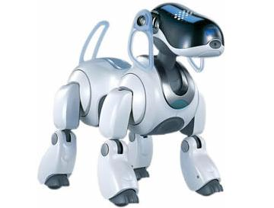
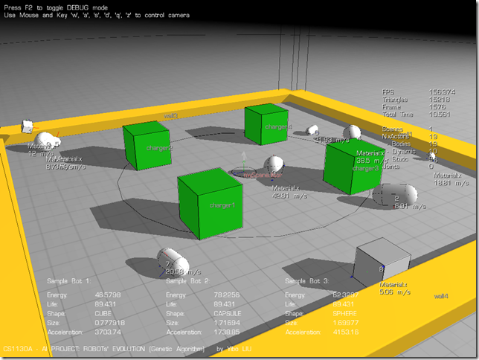
Scope of CI
Practical adaptation concepts, paradigms, algorithms and implementations that enable or facilitate appropriate actions (intelligent behavior) in complex and changing environments.

Slide 60
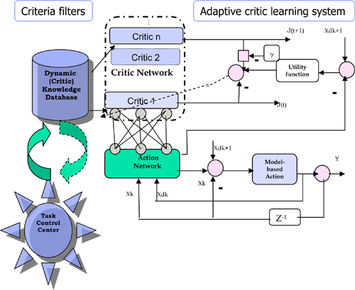
Scope of CI
Fuzzy, imprecise or imperfect data
No available mathematical algorithm
Optimal solution unknown
Rapid prototyping required
Only domain experts available
Robust system required
Learning capability
More recently:
DNA Computing
Quantum Computing

Slide 61
Importance of CI
Solve the problems in realistic situation ( not ideal) such as fuzzy, imperfect or incomplete, only domain experts available.
Complementary approaches with mathematical based algorithm solutions
Encourage new technology development especially in Quantum and DNA computing.

Slide 62

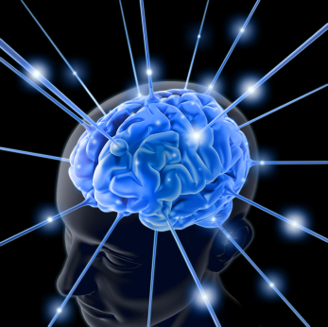
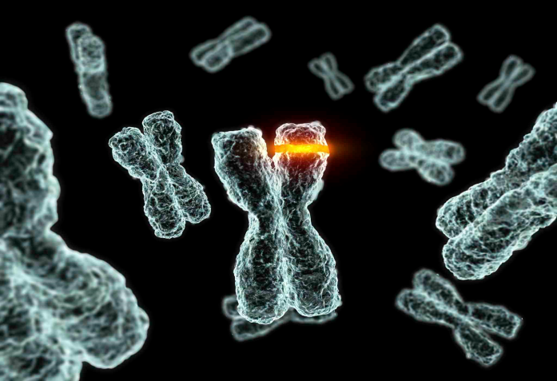
CI Techniques
Artificial Neural Network
Genetic Algorithm
Fuzzy Logic

